Slide 1
STAT 221-FUNDAMENTALS OF STATISTICAL DATA ANALYSIS
Week 10- Probability for social science -1
Shivakumar Jolad

Slide 2
Probability for social science

Slide 3
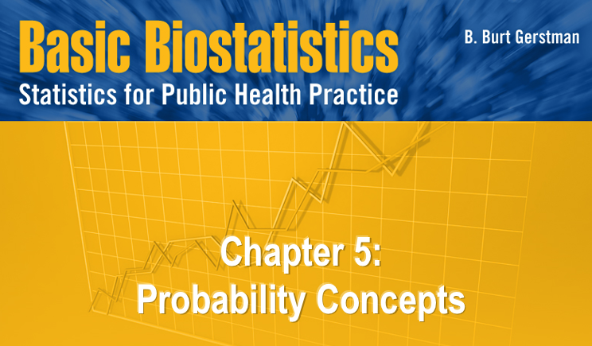
sections
What is Probability?
Types of Random Variables
Discrete Random Variables
Continuous Random Variables
More Rules and Properties of Probability

Slide 4
Definitions
Random variable ≡ a numerical quantity that takes on different values depending on chance
Population ≡ the set of all possible values for a random variable
Event ≡ an outcome or set of outcomes
Probability ≡ the relative frequency of an event in the population … alternatively… the proportion of times an event is expected to occur in the long run

Slide 5
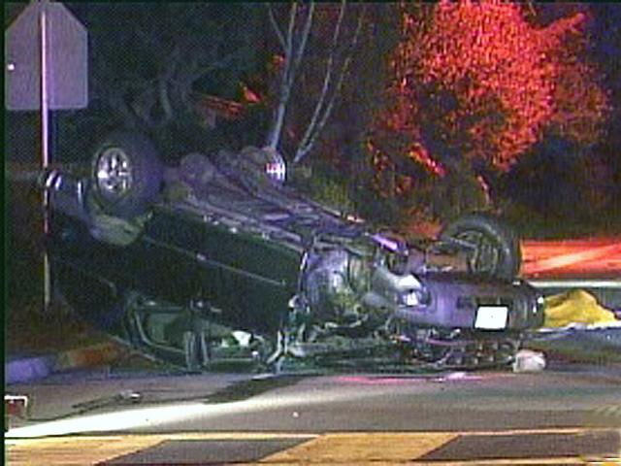
Example
In a given year: 42,636 traffic fatalities (events) in a population of N = 293,655,000
Random sample population
Probability of event = relative freq in pop = 42,636 / 293,655,000 = .0001452 ≈ 1 in 6887

Slide 6
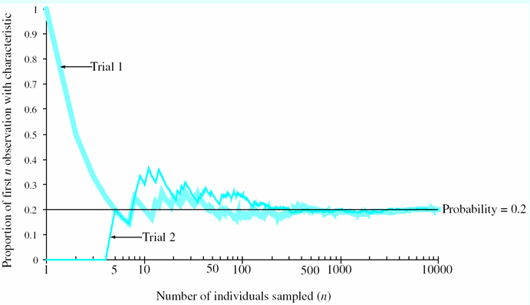
Example: Probability
Assume, 20% of population has a condition
Repeatedly sample population
The proportion of observations positive for the condition approaches 0.2 after a very large number of trials

Slide 7

Basic probability
https://www.youtube.com/watch?v=iLaSpfgVmCA

Slide 8
Quantifying Uncertainty
Probability is used to quantify levels of belief:
Probability | Expression
0.00 | Never
0.05 | Seldom
0.20 | Infrequent
0.50 | As often as not
0.80 | Very frequent
0.95 | Highly likely
1.00 | Always

Slide 9
Random Variables
Random variable ≡ a numerical quantity that takes on different values depending on chance
Two types of random variables
Discrete random variables (countable set of possible outcomes)
Continuous random variable (unbroken chain of possible outcomes)

Slide 10

Example: Discrete Random Variable
Treat 4 patients with a drug that is 75% effective
Let X ≡ the [variable] number of patients that respond to treatment
X is a discrete random variable can be either 0, 1, 2, 3, or 4 (a countable set of possible outcomes)
Social science example:
In a population – 75% literacy ;
If you randomly pick a sample of 4 people
X= no of people who are literate
X={0,1,2,3,4}
Chance that a random person literate? 3/4
Notes:
Social science example:
In a population – 75% literacy ;
If you randomly pick a sample of 4 people
X= no of people who are literate
X={0,1,2,3,4}

Slide 11
Example: Discrete Random Variable
Discrete random variables are understood in terms of their probability mass function (pmf)
pmf ≡ a mathematical function that assigns probabilities to all possible outcomes for a discrete random variable.
This table shows the pmf for our “four people” example:
x | 0 (none literate) | 1 (one literate) | 2 (two are literate) | 3 (three are literate) | 4 (All four are literate)
Pr(X=x) | 0.0039 | 0.0469 | 0.2109 | 0.4219 | 0.3164

Slide 12
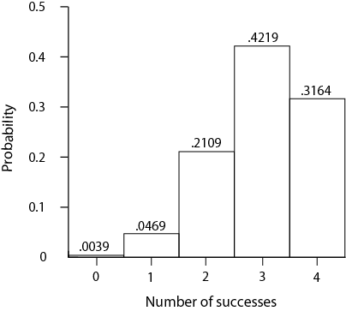
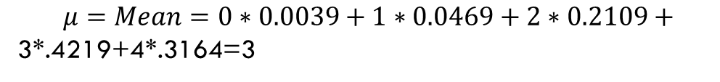
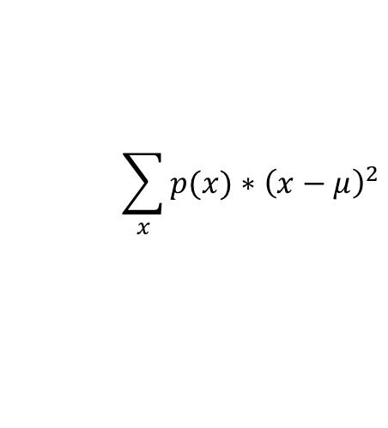
pmf can also be shown graphically
$$μ=Mean=0∗0.0039+1∗0.0469+2∗0.2109+$$
3*.4219+4*.3164=3
$${\sum_{x}{p(x)}∗\left(x−μ\right)}^{2}$$

Slide 13
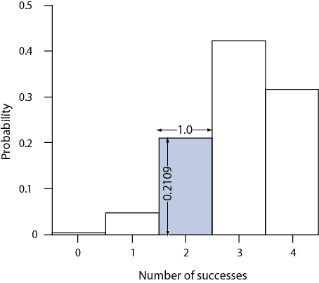
Area on pmf = Probability
Areas under pmf graphs correspond to probability
For example: Pr(X = 2) = shaded rectangle = height × base = .2109 × 1.0 = .2109
“Four patients” pmf

Slide 14

Probability- multiplication rule + Conditional probability
https://www.youtube.com/watch?v=8zMuKn2qORA

Slide 15
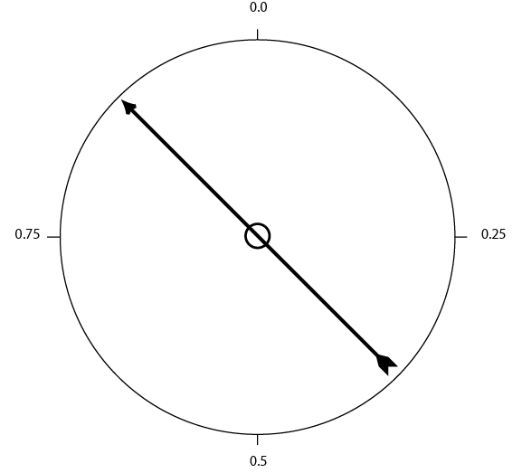
Example: Continuous Random Variable
Continuous random variables have an infinite set of possible outcomes
Example: generate random numbers with this spinner ⇒
Outcomes form a continuum between 0 and 1

Slide 16
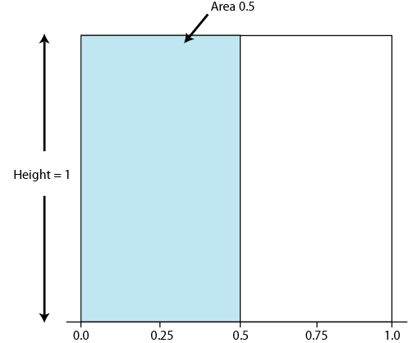
Example : Continuous Random Variable
probability density function (pdf) ≡ a mathematical function that assigns probabilities for continuous random variables
The probability of any exact value is 0
BUT, the probability of a range is the area under the pdf “curve” (bottom)

Slide 17
Example : Continuous Random Variable
Area = probabilities
The pdf for the random spinner variable ⇒
The probability of a value between 0 and 0.5 Pr(0 ≤ X ≤ 0.5) = shaded rectangle = height × base = 1 × 0.5 = 0.5

Slide 18
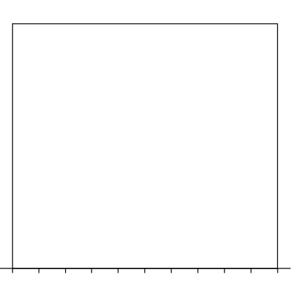
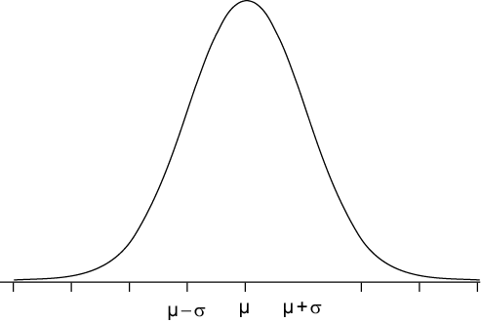
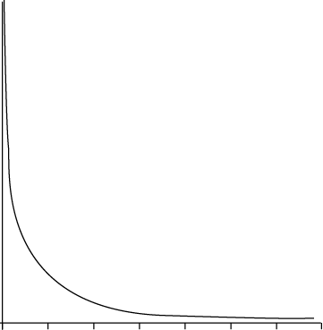
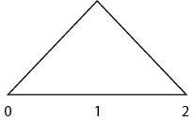
Pdf’s come in various shapes here are examples
Uniform pdf
Normal pdf
Chi-square pdf
Triangular

Slide 19
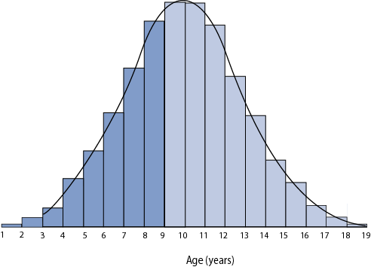
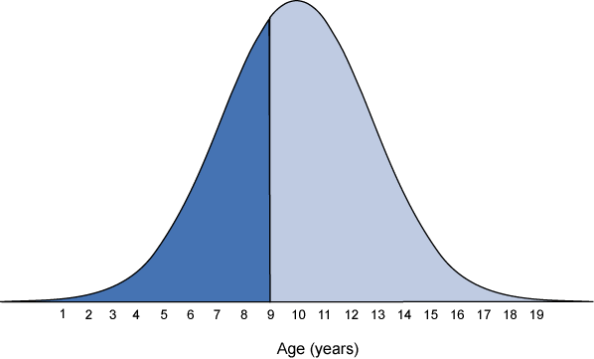
Areas Under the Curve
pdf curves are analogous to probability histograms
AREAS = probabilities
Top figure: histogram, ages ≤ 9 shaded
Bottom figure: pdf, ages ≤ 9 shaded
Both represent proportion of population ≤ 9

Slide 20
Properties of Probabilities
Property 1. Probabilities are always between 0 and 1
Property 2. The sample space (S) for a random variable represents all possible outcomes and must sum to 1 exactly.
Property 3. The probability of the complement of an event (“NOT the event”)= 1 MINUS the probability of the event.
Property 4. Probabilities of disjoint events can be added.

Slide 21
Properties of Probabilities In symbols
Property 1. 0 ≤ Pr(A) ≤ 1
Property 2. Pr(S) = 1
Property 3. Pr(Ā) = 1 – Pr(A), Ā represents the complement of A
Property 4. Pr(A or B) = Pr(A) + Pr(B) when A and B are disjoint
S (sample space)

Slide 22
Properties 1 & 2 Illustrated
Property 1. Note that all probabilities are between 0 and 1.
Property 2. The sample space sums to 1: Pr(S) = .0039 + .0469 + .2109 + .4219 + .3164 = 1
“Four people- literate” pmf

Slide 23
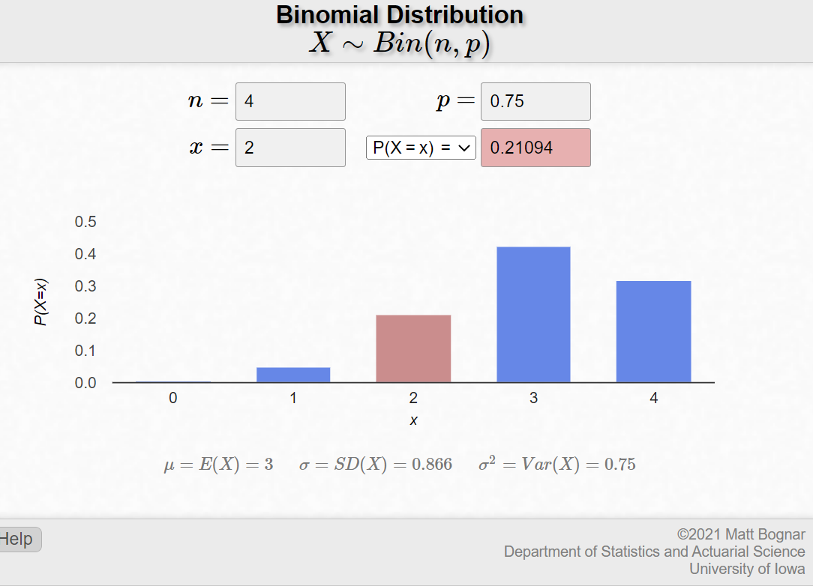
Binomial distribution
0.0039 | 0.0469 | 0.2109 | 0.4219 | 0.3164
https://homepage.divms.uiowa.edu/~mbognar/applets/bin.html

Slide 24
Property 3 (“Complements”)
Let A ≡ 4 successes
Then, Ā ≡ “not A” = “3 or fewer successes”
Property of complements:
Pr(Ā) = 1 – Pr(A) = 1 – 0.3164 = 0.6836
“Four patients” pmf
Ā
A

Slide 25
Property 4 (Disjoint Events)
Let A represent 4 successes
Let B represent 3 successes
A & B are disjoint
The probability of observing 3 or 4: Pr(A or B)
= Pr(A) + Pr(B)
= 0.3164 + 0.4129
= 0.7293
“Four patients” pmf
B
A

Slide 26
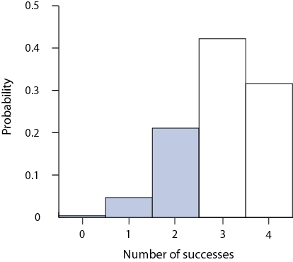
Cumulative Probability: Left “tail”
Cumulative probability = probability of x or less
Denoted Pr(X ≤ x)
Corresponds to area in left tail
Example: Pr(X ≤ 2) = area in left tail = .0039 + .0469 + .2109 = 0.2617
.2109
.0469
.0039

Slide 27
Right “tail”
Probabilities greater than a value are denoted Pr(X > x)
Complement of cumulative probability
Corresponds to area in right tail of distribution
Example (4 patients pmf): Pr (X > 3) = complement of Pr(X ≤ 2) = 1 - 0.2617 = .7389
.2109
.0039
.0469

Slide 28
Mean and Variance of a Discrete RV
Definitional formulas
The mean, i.e., expectation
The variance

Slide 29
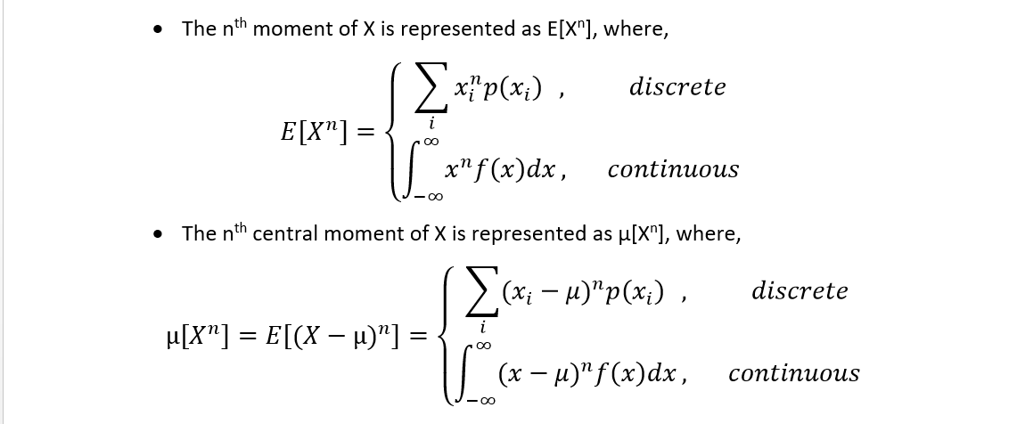
Moments of probability distribution
Central Moment

Slide 30
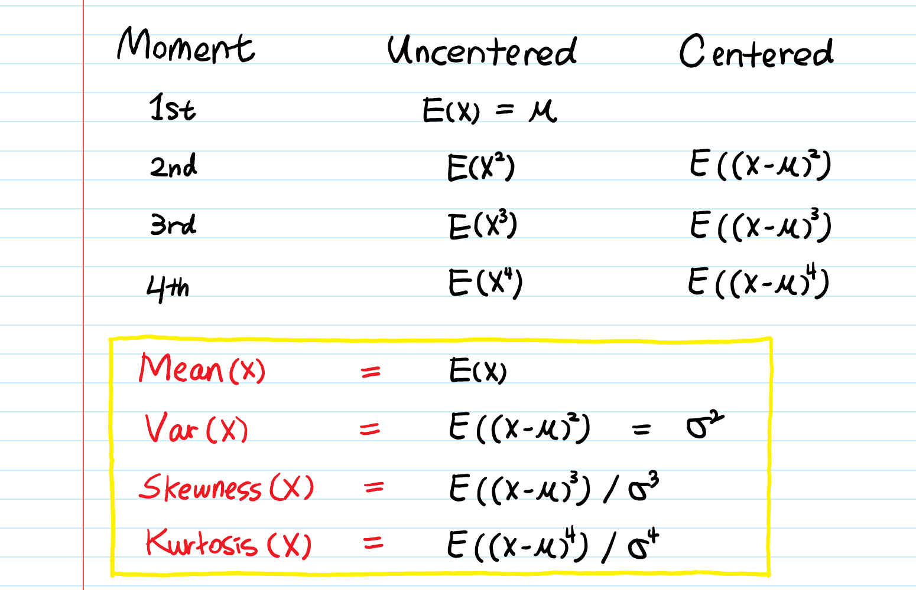

Slide 31
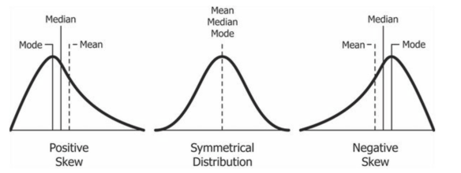
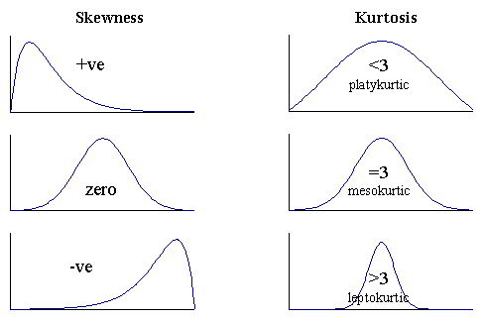

Slide 32
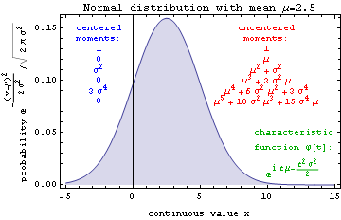
Moments for normal distribution

Slide 33
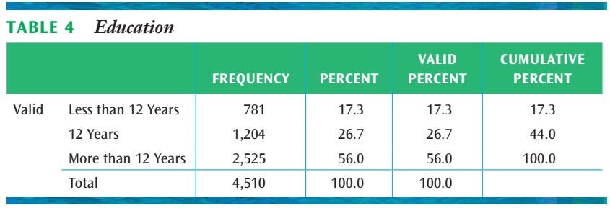
Probability using frequency tables
17.3% of the population has less than 12 years of education, 26.7% has 12 years of education, and 56.0% has more than 12 years of education.
The probability of randomly selecting a respondent with less than 12 years of education is P = .173.
P(Completed 12 years of education)= .267
P(Completed more than 12 years of education)= .56
P(12 or more years completed)=0.267+0.56=0.827
Assumption of sampling randomly

Slide 34
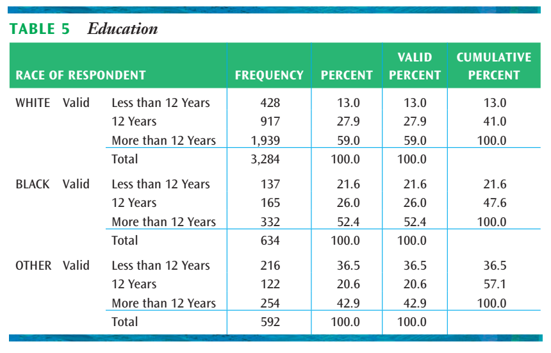
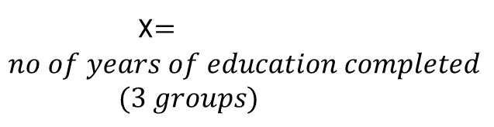
Education completion vary by race?
X$=no of years of education completed$ $$(3 groups)$$

Slide 35
